Slide 1
Direct Methods For
Requirement Gathering
By
Piyush Modi 14030121039
Aakash Anand 14030121032
Atul Tiwari 14030121017
Rohan Naik 14030121007

Slide 2
 | Direct Methods | Short explanation
1) | Individual face to face interview | A one-on-one visit with the user to obtain information. It may be structured or somewhat open-ended.
2) | Telephone Interview or Survey | A structured interview conducted via telephone.
3) | Traditional Focus Group | A small group of users and a moderator brought together to verbally discuss the requirements.
4) | Facilitated Team Workshop | A facilitated, structured workshop held with users to obtain requirements information. Similar to the Traditional Focus Group.
5) | Observational Field Study | Users are observed and monitored for an extended time to learn what they do.
6) | Requirements Prototyping | A demo, or very early prototype, is presented to users for comments concerning functionality.
7) | User-Interface Prototyping | A demo, or early prototype, is presented to users to uncover user-interface issues and problems.
8) | Usability Laboratory Testing | Users at work are observed, evaluated, and measured in a specially constructed laboratory.
9) | Card Sorting for Web Sites | A technique to establish groupings of information for Web sites

Slide 3
Individual Face-to-Face Interview
A one-on-one visit is held with the user. It may be structured or more open-ended. The interview must have focus and topics to be covered must be carefully planned so data is collected in a common framework, and to ensure that all important aspects are thoroughly covered. A formal questionnaire should not be used.
Example:-
If designing a Web site, the following kinds of interview questions are appropriate for asking potential users:
-Present a site outline or proposal and then we can request comments from potential user on content coverage of website, and also suggestions for additional content.
-Ask users to describe situations in which the proposed Web site might be useful.
-Ask users to describe what is liked and disliked about the Web sites of potential competitors.
-Ask users to describe how particular Web site tasks should be accomplished.

Slide 4
Telephone Interview or Survey
This interview is conducted using the telephone.
It must have structure and be well planned.
Arranging the interview in advance allows the user to prepare for it.
Telephone interviews are less expensive and less invasive than personal interviews.
They can be used much more frequently and are extremely effective for very specific information.
Some Disadvantages:-
Telephone interviews have some disadvantages.
It is impossible to gather contextual information, such as a description of the working environment, replies may be easily influenced by the interviewer’s comments, and body language cues are missing.
It may be difficult to contact the right person for the telephone interview.
Example:-
Sample Questions to be asked in telephone interview or survey.
Q1) Why did you leave your previous job?
Q2) What is your current position in the company?
Q3) What are your strength and weaknesses?

Slide 5
Traditional Focus Group
1)A small group of users (8 to 12) and a mediator are brought together to discuss the requirements.
2)The range of topics must be determined beforehand.
3)The session lasts about two hours.
4)The purpose of a focus group is to probe user’s experiences, attitudes, beliefs, and desires, and to obtain their reactions to ideas or prototypes.
5)Focus group discussion can be influenced by group dynamics, for good or bad.
6)Recording of the session, either video or audio, helps in detailed analysis of participant’s comments. The recording can also be played for the entire design team and for providing insights into user needs for all developers.
Setting up focus group involves the following :-
->Establish the objectives of the session.
->Select participants representing typical users, or potential users.
->Write a script for the moderator to follow.
->Find a skilled moderator to facilitate discussion, to ensure that the discussion remains focused on relevant topics, and to ensure that everyone participates.
->Allow the moderator flexibility in using the script.
Take good notes, using the session recording for backup and clarification.

Slide 6
Facilitated Team Workshop
A facilitated team workshop is similar in structure and content to a traditional focus group but is slightly less formal. A common technique used in system requirements determination for many years, it is now being replaced (at least in name) by focus groups. Team workshops have had the potential to provide much useful information. Like focus groups, they do require a great deal of time to organize and run.

Slide 7
Observational Field Study
To see and learn what users actually do, they are watched and followed in their own environment, office, or home, in a range of contexts for a period of time. Observation provides good insight into tasks being performed, the working environment and conditions, the social environment, and working practices. It is more objective, natural, and realistic. Observation, however, can be time-consuming and expensive. Video recording of the observation sessions will permit detailed task analysis. Playing the recording for the entire design team again provides all involved with some insights into user tasks.

Slide 8
Requirements Prototyping
A demonstration model, or very early prototype, is presented to users for their comments concerning functionality.

Slide 9
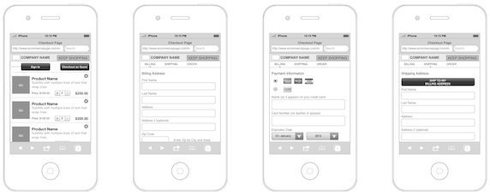
User-Interface Prototyping
A demonstration model, or early prototype, is presented to users to uncover user interface issues and problems.

Slide 10
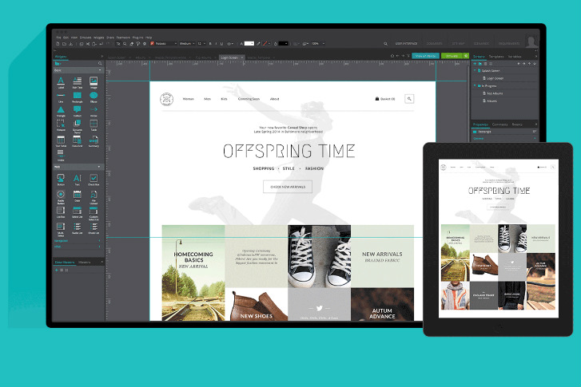
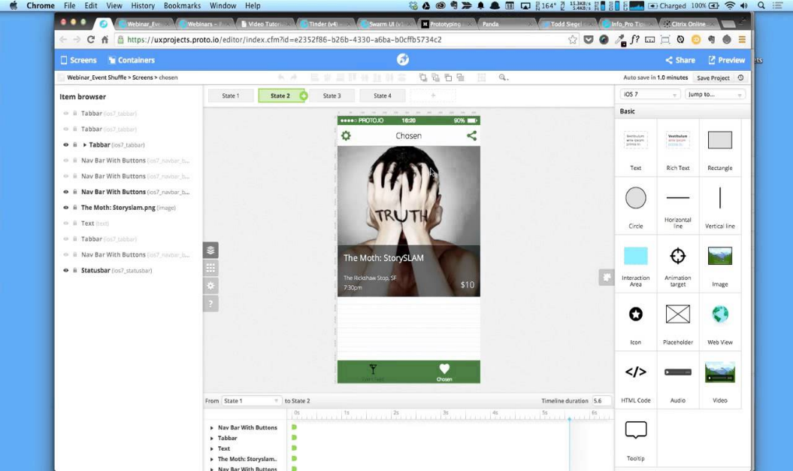
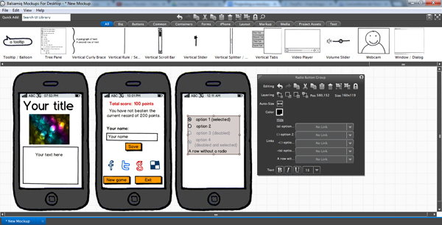
Example of Prototyping Tools
Invision
Marvel
Justinmind
Axure
Proto.Io
Balsamiq

Slide 11
Usability Laboratory Testing
It Tests measure a users ability to complete task. In typical usability laboratory testing, a user attempts to complete a task using a website.
Each of these tests have a specified goal with effectiveness, efficiency and satisfaction identified in a specified context of use.

Slide 12
Card Sorting for Websites
Card Sorting is a method used to help design or evaluate the information architecture of a site.
To conduct a card sort, we can use actual cards, piece of paper or one of the several online card sorting software tools.

Slide 13
THANK YOU

